Slide 1

mkarta.uz a medical record web site
technical task

Slide 2
The purpose of the website mkarta.uz
Keep user health information, diagnostic answers, treatment recommendations in one place;
Allows doctors to give advice on treatment or improving health;
Prepare reports on user health changes over time.

Slide 3
Information about software and hosting mkarta.uz
The site is developed in the joomla CMS environment.
Program codes are fully located in the public repository https://github.com/ruslanbek05/mkarta.uz.git;
Hosting service from hostinger.com.

Slide 4
Confidentiality of information
User data is accessible only to the user and the doctors. Not visible to other users.
User’s can be added into the group of doctors only on the basis of the submitted documents.

Slide 5
Menu (for users)
Меню | Изоҳ
Analyzes | Information about the user's health is entered (description, image, date)
Doctors Recommendations

Slide 6
Menu(for doctors)
Меню | Изоҳ
Analyzes | Information about the user's health is entered (description, image, date)
Doctor Information | Here doctors upload documents confirming their doctorate. The site administrator adds the user to the group of doctors based on the uploaded documents. All users will have access to the doctor’s information.
Users list | From this list, the doctor will find the patient he needs.
Doctors Recommendations

Slide 7
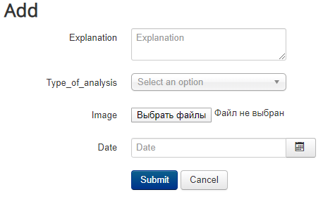
Health Information Entry Form

Slide 8
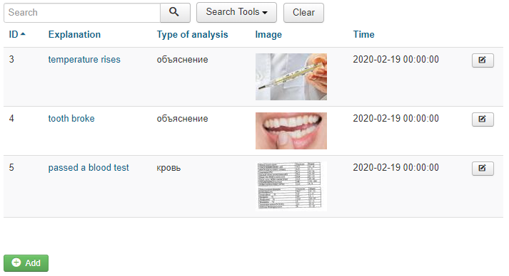
List of analyzes
Click here for more information.

Slide 9
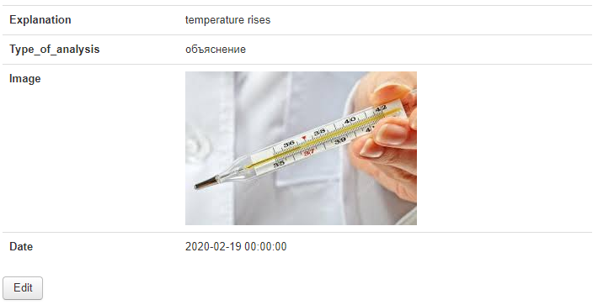
Analysis Details
The doctor will review the client's analysis and give him / her instructions and recommendations as needed. Here will be a button to add a recommendation.

Slide 10
Users list
Search
Login | email | Year of birth
Ivanov | Ivanov@gmail.com | 1980
James | james@gmail.com | 1965
This table is visible only to doctors, and doctors will find the needed user.

Slide 11
Sources of site revenue
Advertising;
Due to the commission paid by users for the voluntary encouragement of doctors' recommendations.

